Slide 1
Data-Driven Engineering to Improve CS Education
Dr. Sharon Hsiao
Arizona State University
2021.01.28
http://www.public.asu.edu/~ihsiao1/
@shoha99

Slide 2
Agenda
Introduction
Research projects:
R1: Behavioral Analytics and Modeling
R2: Learning Computational Thinking in Augmented Reality
Q&A

Slide 3
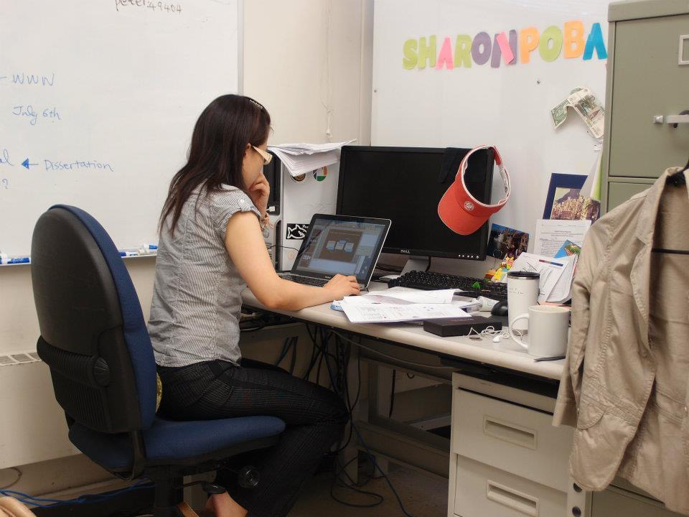
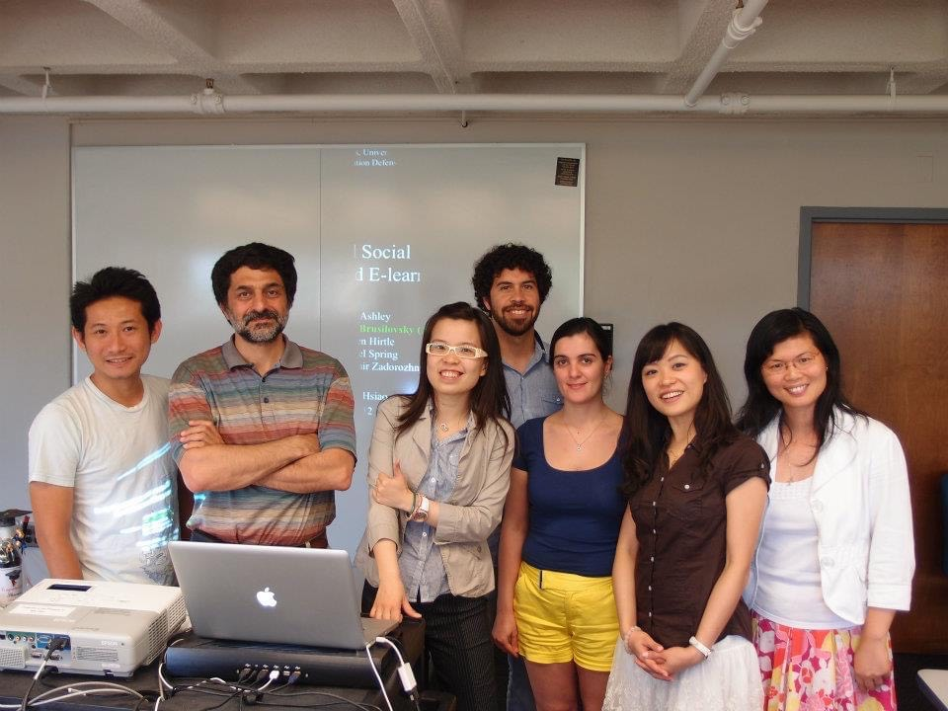
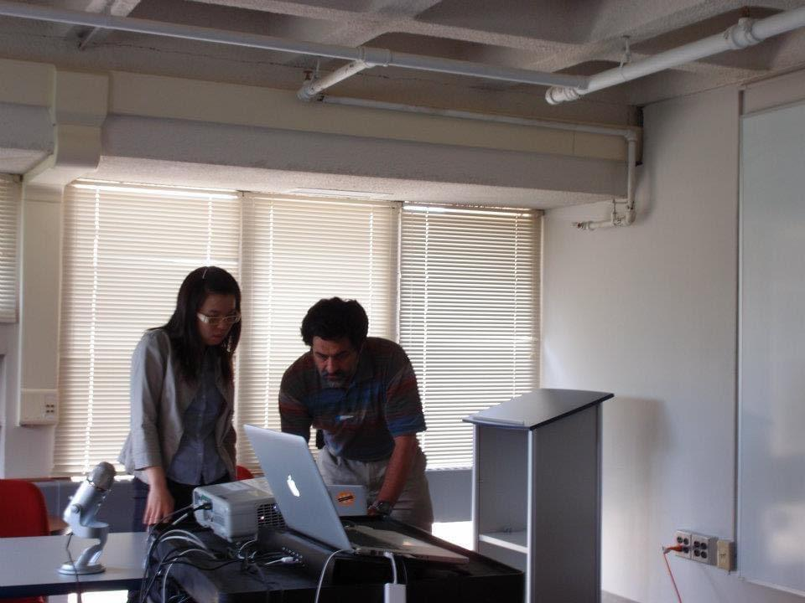

Slide 4
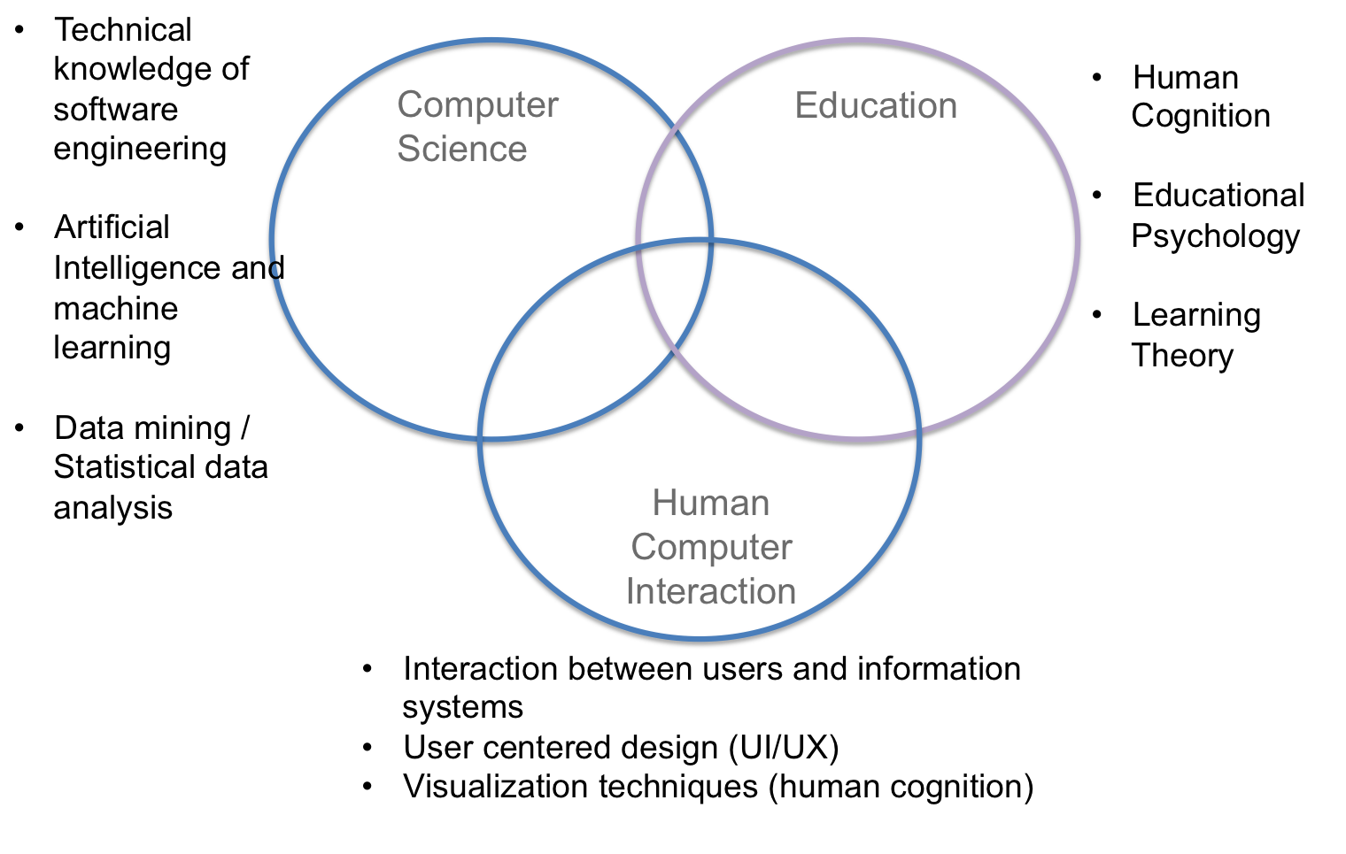
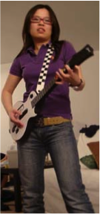
My background: Information & Data Sciences

Slide 5


Slide 6



CSI (Computing Systems & Informatics) Lab @ ASU
https://sites.google.com/a/asu.edu/csi/home
Google Sharon Hsiao ASU
http://www.public.asu.edu/~ihsiao1/
Notes:
4.5 PhD students
1 MS
2 Undergrads
Once a lifetime outstanding faculty award in 2019

Slide 7

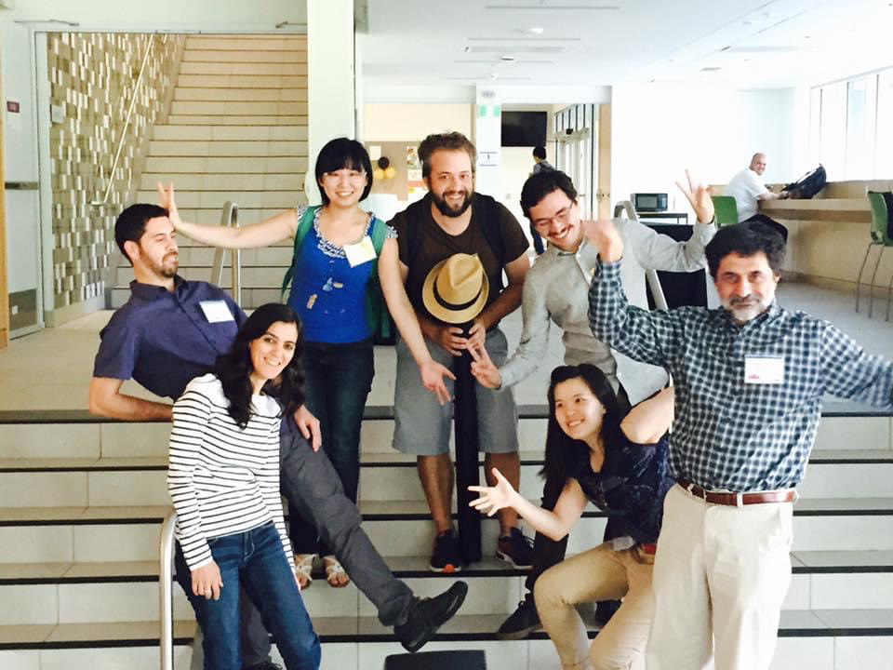
HT’2016 @ Halifax
Closing the Loop on Personalized Programming Learning in Blended Instruction Classes (2016)

Slide 8
At the time...some of the research questions...
How much do novices learn programming in Just-In-Time learning paradigm?
Will integrate formal and informal learning analytics bridge the gap between cyber and physical programming classes?
How to design next generation of automated assessment tools to assist computing education? (i.e. examples in math)
Designing technology that integrates analytics to address and support the potential weak link between Assessment and Instruction

Slide 9



WPGA (Web Programming Grading Assistant)
QuizIT (Quiz of the Day)
Ogmented (Learn CT in AR)
PiSA (Personalized Information Seeking Assistant)
CodeReco (Semantic code recommender)
Study Genie (Intelligent Notes/Cheatsheet Agent)
Progressor⁺ (Visual Learning Analytics)
…
7.5 PhD
10 MS
5 Undergrad
-------------
6 journals
39 conference papers
-------------
Avg > 2 pubs/student

Slide 10

Current and Completed grants
NSF: Cultural Anthropology program (Co-PI) 155K/2yrs
SocioMap: A network-based system to facilitate data synthesis involving complex, evolving sets of sociopolitical entities.
NSF: RAISE (Co-PI) 998K/1yr
Safe Skill-Aligned On-The-Job Training with Autonomous Systems.
DoD: Advanced Distributed Learning (ADL) (Co-PI) 890K/2yrs
Science of Learning for Education and Readiness.
NSF: NRI (PI) 250K/3yr
Collaborative Research: Understanding the Influence of a Teachable Robot on STEM Skills and Attitudes.
Several internal fundings:
Embodied XR: Ebola Resource Decision Enabler.
Institute for Social Science Research Seed Grant: Advancing personalized learning across physical and digital spaces: A data-driven learning analytics approach.

Slide 11
R1: Behavioral Analytics & Modeling

Slide 12
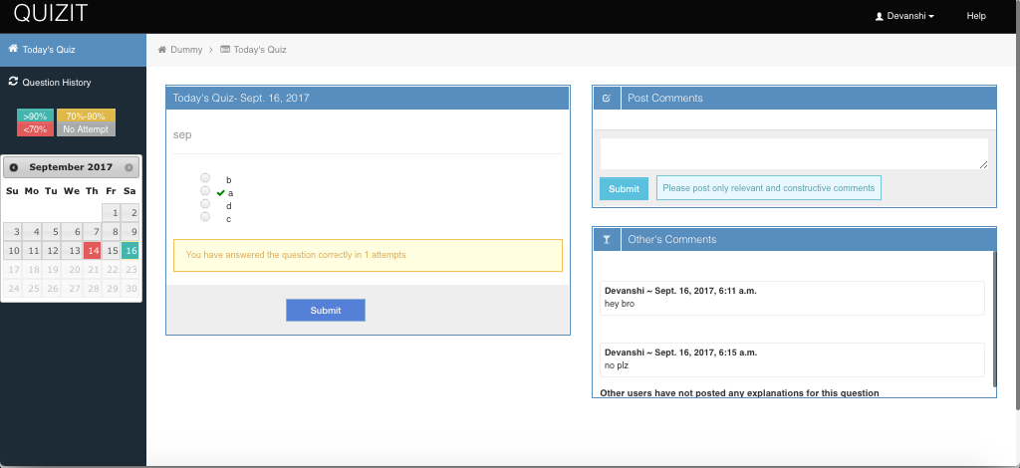
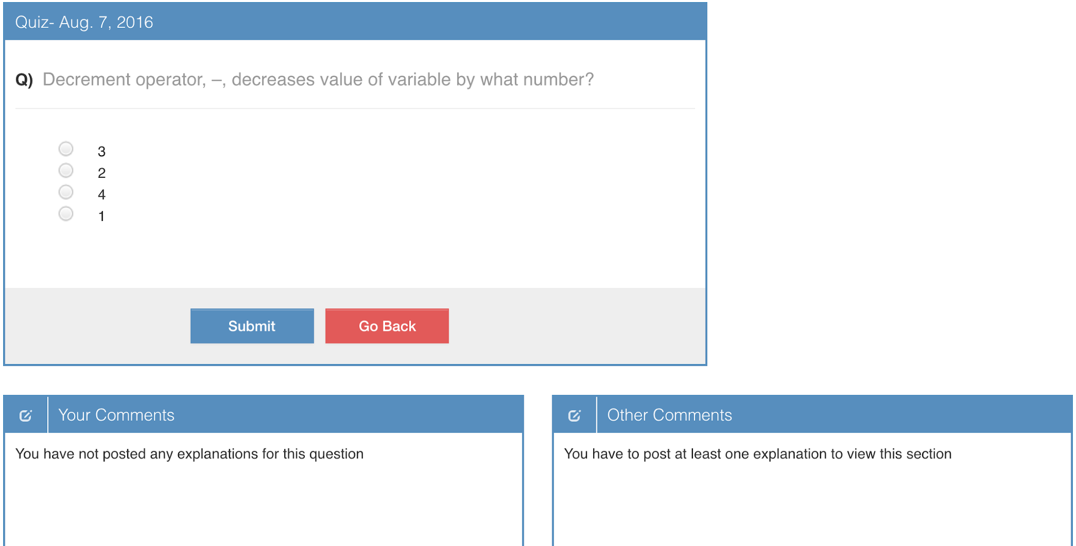
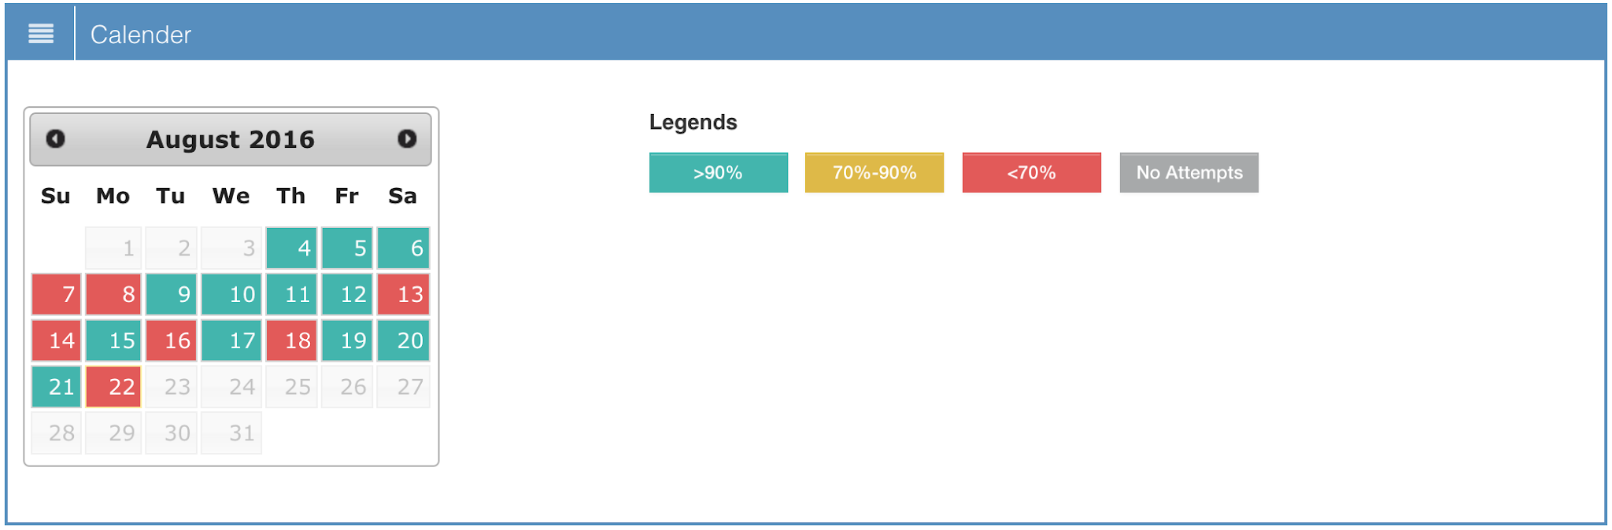
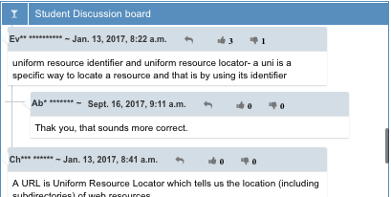
Platform: QuizIT
Data:
600+ users/semester
student’s attempts, time, reflection, success rate, sessions, etc.
2.
3.
Learning Sciences principles:
Distributed practice (Rohrer, 2015)
Retrieval practice and testing effects (Roediger & Butler, 2011)
Reflection and metacognition (Hacker, Dunlosky, & Graesser, 1998; Zimmerman & Schunk, 2012)
Feedback (Butler & Winne, 1995; Shute, 2008)
Peer interaction (Roscoe & Chi, 2007; Topping, 2005)
4.
1.
5.
Notes:
Theories
Functionalities
Publications

Slide 13
Methodology
H1: Students’ problem solving tactics can be classified based on the sequences of their problem solving actions, and behavioral patterns are correlated to the performances.
H2: Students’ studying patterns can be clustered as click-stream (response-stream) data, and study persistency positively affects performances.
Differential sequential mining
Poisson mixture modeling
Notes:
pubs

Slide 14
R1: Behavioral Analytics & Modeling
R1.1: Modeling Problem-Solving Tactics

Slide 15
Building Action Sequences
Action sequence formed by action segment {Complexity, Correctness, Duration}
Complexity ∈ {Easy, Moderate, Difficult}
Correctness ∈ {1, 2}
Duration ∈ {F, S, M, L, VL, XL}
For instance, <Easy-1-F> represents a question of easy difficulty that was answered correctly on the first attempt.
Notes:
•Univariate k-means clustering used for finding duration break points, best BIC for k=4 : -39192.96
thresholds:
–F : First occurrence
–S : 6.3287 sec
–M : 121.0022 sec
–L : 394.4931 sec
–VL : 914.5216 sec
–XL : >914.5216 sec

Slide 16
Differential Sequential Mining
Action sequence assigned to students performance (median score)
Higher performing
Lower performing
Metrics to measure pattern frequency:
s-frequency : # of sequences in a database containing a specific pattern
i-frequency : # of times a pattern appearing in a single sequence
s-support >= 0.3
i-support considered maximum gap constraint : 2
p-value threshold was set at 0.05
Notes:
DSM algorithm, Maximum gap constraint : 2
I.e. P- B-X-Q-S-R, a frequent pattern <P-Q-R>

Slide 17
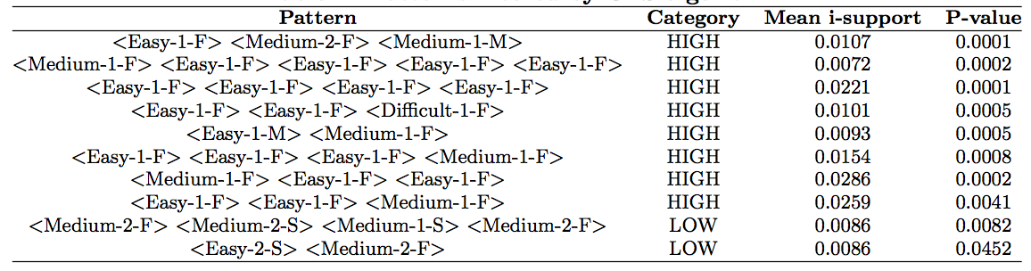
Feature selection & modeling
35 s-frequent patterns : 23 high-performing and 12 low-performing
CFS with 10-fold CV used for feature selection (patterns in at least 5 CV included)
8 high-performing and 2 poor-performing patterns retrieved from CFS

Slide 18
Problem solving tactics were found.
Persistent-practicing
<Easy-1-F> <Easy- 1-F> <Easy-1-F> <Easy-1-F>
Steady-progression
<Easy-1-M> <Medium-1-F>
Experimental-progression
<Easy-1-F> <Medium- 2-F> <Medium-1-M>
Jump-forward-progression
<Easy- 1-F> <Easy-1-F> <Medium-1-F>
Jump-backward-progression
<Medium- 1-F> <Easy-1-F> <Easy-1-F>
Struggling
<Medium-2-F> <Medium-2-S> <Medium- 1-S> <Medium-2-F>
Withdrawal
<Easy-2-S> <Medium-2-F>
Notes:
Mandal, P., & Hsiao, I. H. (2018). Using Differential Mining to Explore Bite-Size Problem Solving Practices. In Educational Data Mining in Computer Science Education (CSEDM) Workshop.
Mandal, P. P. (2017). Behavioral Pattern Mining and Modeling in Programming Problem Solving (Masters thesis, Arizona State University).

Slide 19
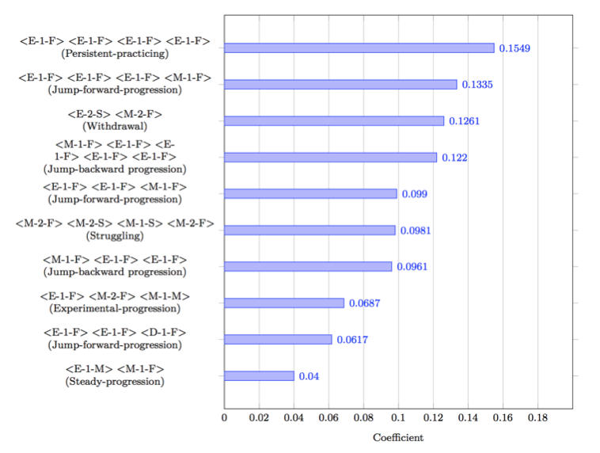
LR & RF models are built to predict student’s performance (course final grades)
Model | Precision | Recall | F1-score
LR | 0.6912 | 0.6777 | 0.6715
RF | 0.6979 | 0.6839 | 0.6777
Lesson learned: persistent practicing feature consistently being important feature regardless what model it is.
Notes:
Mandal, P. P. (2017). Behavioral Pattern Mining and Modeling in Programming Problem Solving (Masters Thesis, Arizona State University).

Slide 20
R1: Behavioral Analytics & Modeling
R1.2: Modeling Studying Persistency

Slide 21

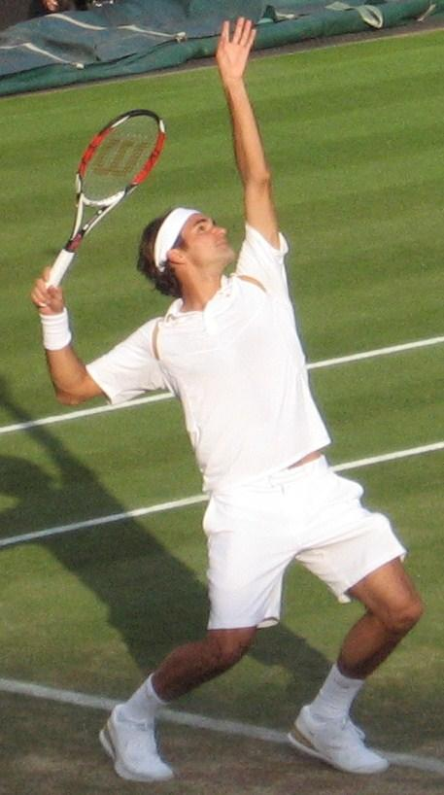

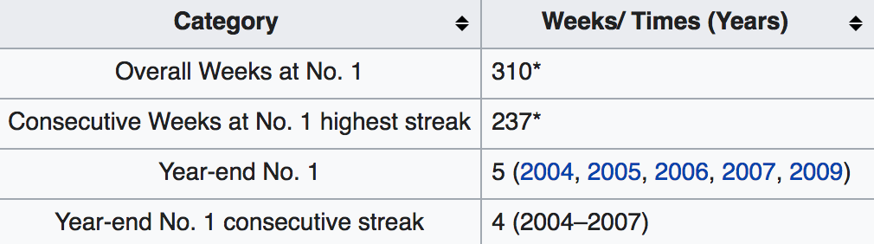
Yes! Persistence Matters!
High persistency across board!

Slide 22
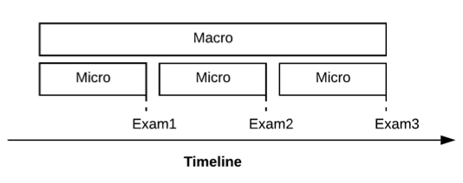
Modeling persistence methodology
Persistence: the degree of continued existence of the effort in a period of time.
●I.e., Amount of effort spent week by week
●Captured by a probabilistic mixture model (Park et al., 2018)

Slide 23
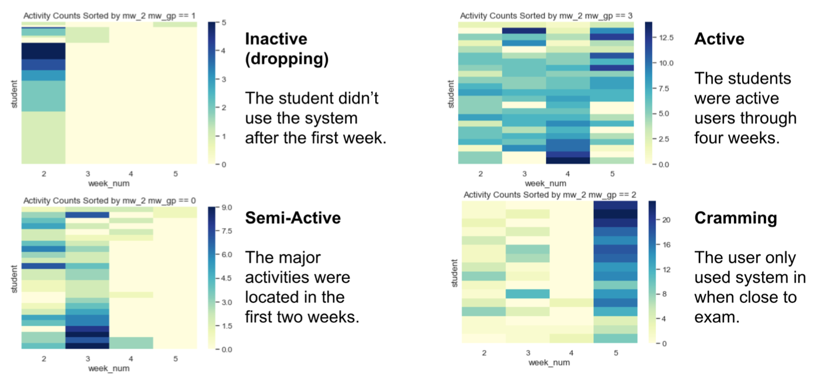
Behavioral Analytics on Persistence and Regularity
Notes:
C. Y. C., & I. H. H. (2019, October). Quantitative Analytics in Exploring Self-Regulated Learning Behaviors: Effects of Study Persistence and Regularity. In 2019 IEEE Frontiers in Education Conference (FIE) (pp. 1-9). IEEE.

Slide 24
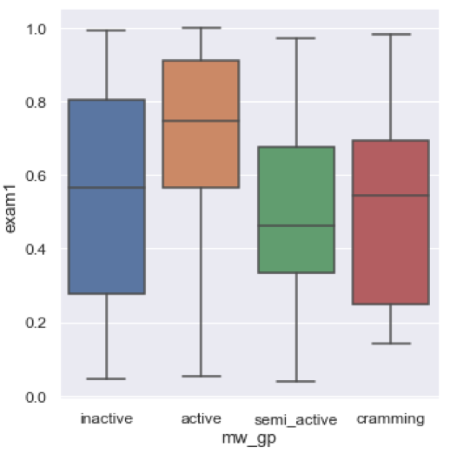
Persistently studying (Active) matters!
Significant differences between Active vs. Inactive, Semi-active, and Cramming.
p=0.045, Cohen’s d=0.551
M_{A}= 0.687, SE=0.275; M_{O}= 0.532, SE=0.280
Notes:
Chung, C. Y., & Hsiao, I. H. (2020, February). Investigating Patterns of Study Persistence on Self-Assessment Platform of Programming Problem-Solving. In Proceedings of the 51st ACM Technical Symposium on Computer Science Education (pp. 162-168).

Slide 25
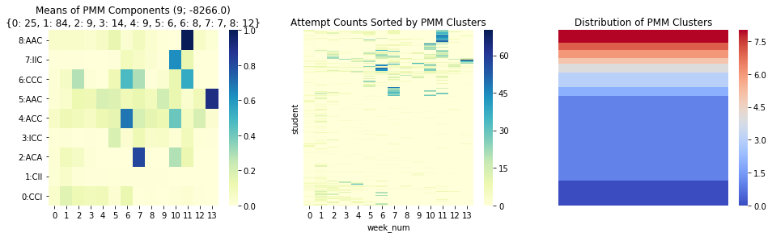
Longitudinal study to examine Macro patterns
Persistence Pattern
Exam 1 Score
Persistence Pattern
Exam 2 Score
Persistence Pattern
Exam 3 Score
A or C or I
A or C or I
A or C or I
Active (A)
:Evenly distributed
Cramming (C)
:Spiked
Inactive (I)
:Minimum
Notes:
Chung, C. Y., Yu, C., Paredes, Y. V., Alzaid, M., Papakannu, K. R., & Hsiao, I. H. A Longitudinal Study on Student Persistence in Programming Self-assessments. (2020, July) In Proceedings of the fourth of CSEDM workshop.

Slide 26
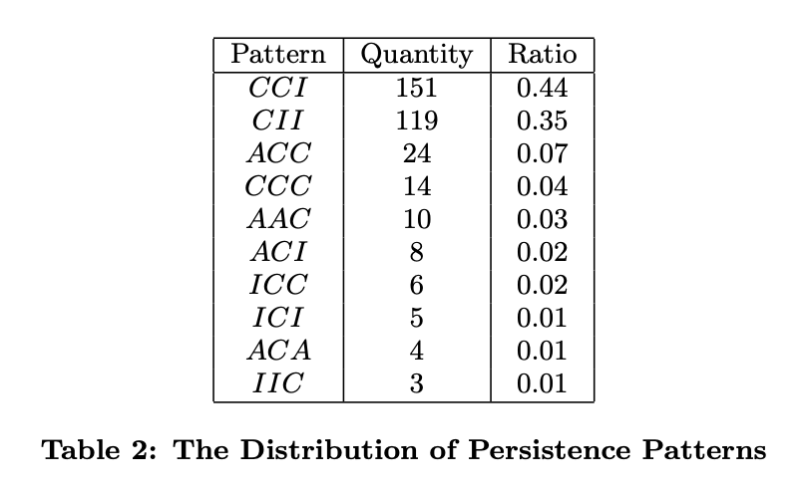
Finding#1:
Active (A)
:Evenly distributed
Cramming (C)
:Spiked
Inactive (I)
:Minimum
Cramming appeared to be a dominant pattern

Slide 27
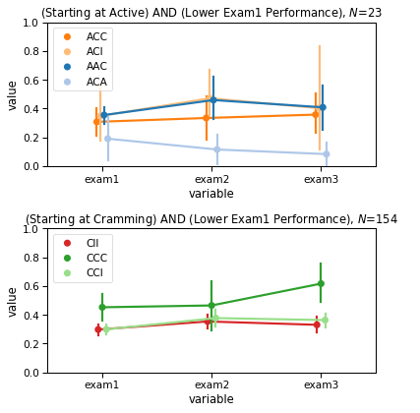
Finding#2: Maintaining studying persistency early on is crucial
Staying Active/Cramming may help for low-performing students.
Topics in E1 (Exam1) and E2 (Exam2) were important for students to build up the fundamentals of programming languages.
Normalized Performance
Exam Period
Normalized Performance
Exam Period

Slide 28
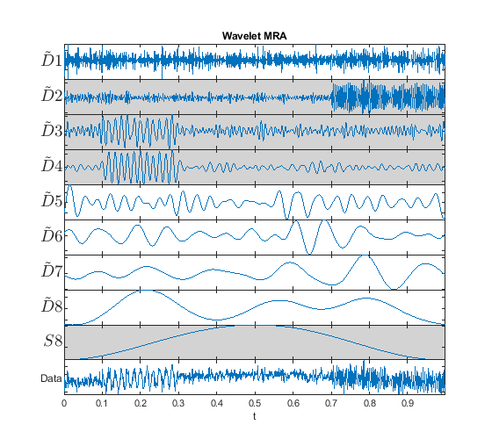
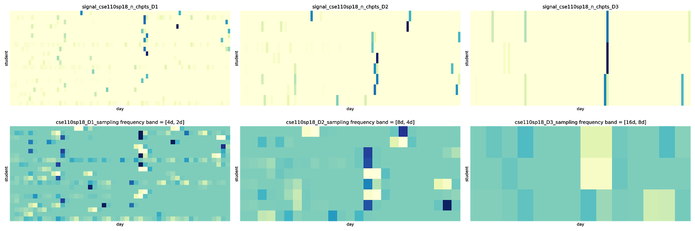
On-going modeling: Signal processing analysis
We applied DWT (Discrete Wavelength Transform) based multiresolution analysis to decompose a signal into components. Which allows us to explore the “Spaced Practice Patterns”.
Hope to share the results in EDM’21!
2-4 days per cycle
4-8 days per cycle
8-16 days per cycle

Slide 29


Please consider to submit papers to EDM’21

Slide 30
R2: Learning Computational Thinking in Augmented Reality

Slide 31
AR in learning CS & CT
Leverage the success in other science subjects (medical, chemistry…), capitalize the highly visual and highly interactive characteristics in AR, in a less explored field, CS.
AR can support discovery- & project-based learning: by enriching learner’s experience by providing opportunities and tools to explore the problem to solve, and foster deeper understanding through such explorations. (Seel, 2011) Learning by doing (Dewey, 2013)
Notes:
N. M. Seel, Encyclopedia of the Sciences of Learning. Springer Science & Business Media, 2011
J. Dewey, “My pedagogic creed,” in Curriculum Studies Reader E2. Routledge, 2013, pp. 29–35.
P. C. Blumenfeld, E. Soloway, R. W. Marx, J. S. Krajcik, M. Guzdial, and A. Palincsar, “Motivating project-based learning: Sustaining the doing, supporting the learning,” Educational psychologist, vol. 26, no. 3-4, pp. 369–398, 1991.
D. Klahr and M. Nigam, “The equivalence of learning paths in early science instruction: Effects of direct instruction and discovery learning,” Psychological science, vol. 15, no. 10, pp. 661–667, 2004.

Slide 32
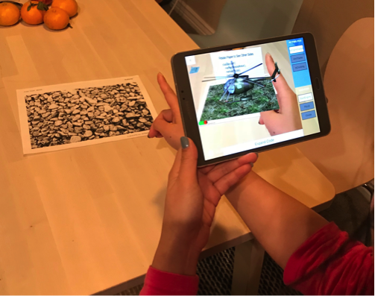
Research platform: Ogmented
Innovative mobile application to learn computational thinking & coding in AR.
Notes:
Project website: https://sites.google.com/asu.edu/ogmented/home

Slide 33
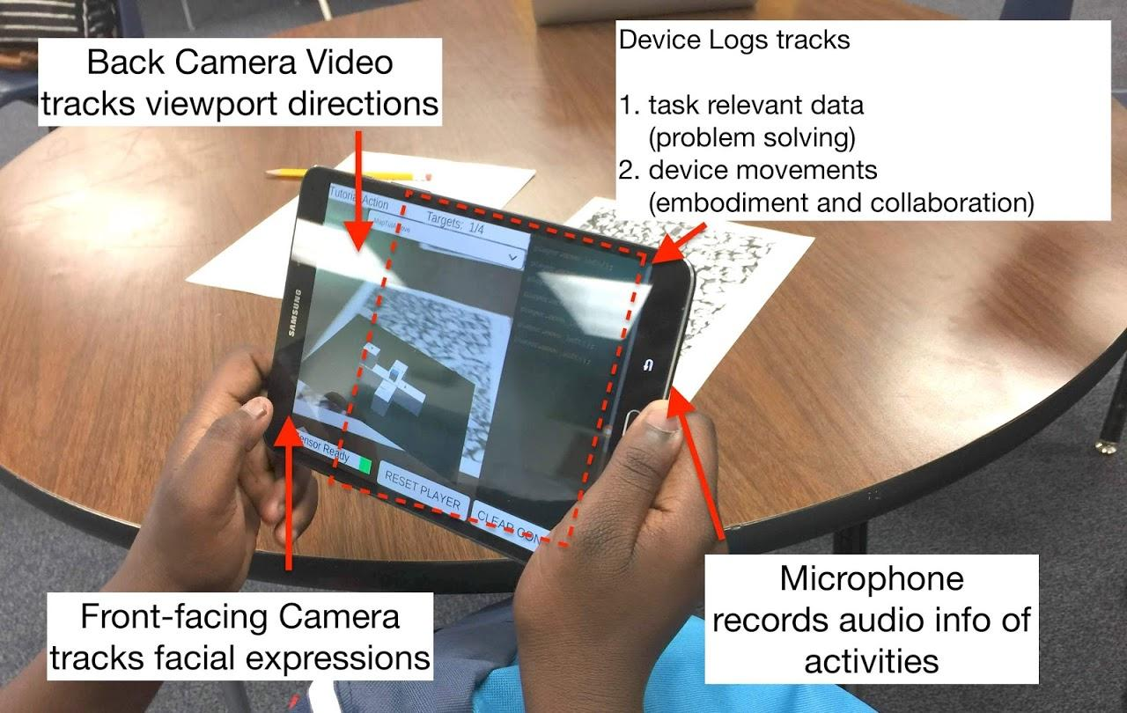
Uniqueness of Ogmented:
Multimodal data analytics collection
Embodiment and collaboration
3D debugging practices
Playful
Accessible & inexpensive

Slide 34
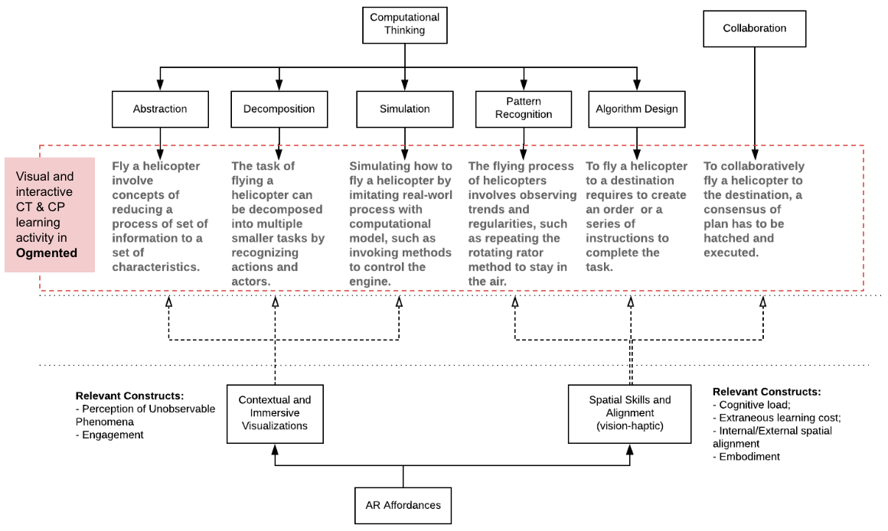
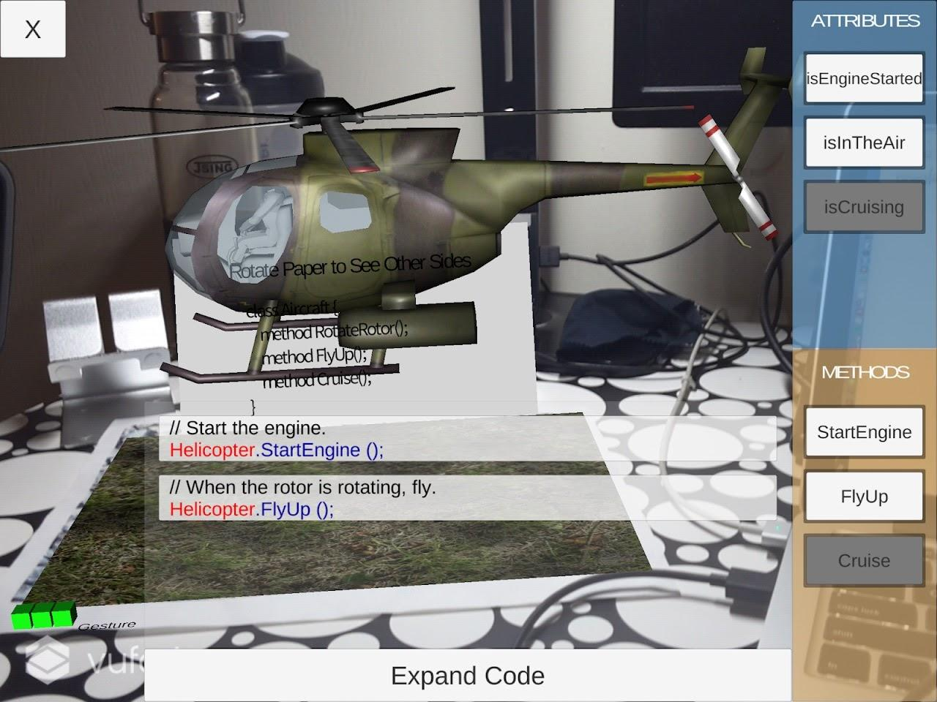
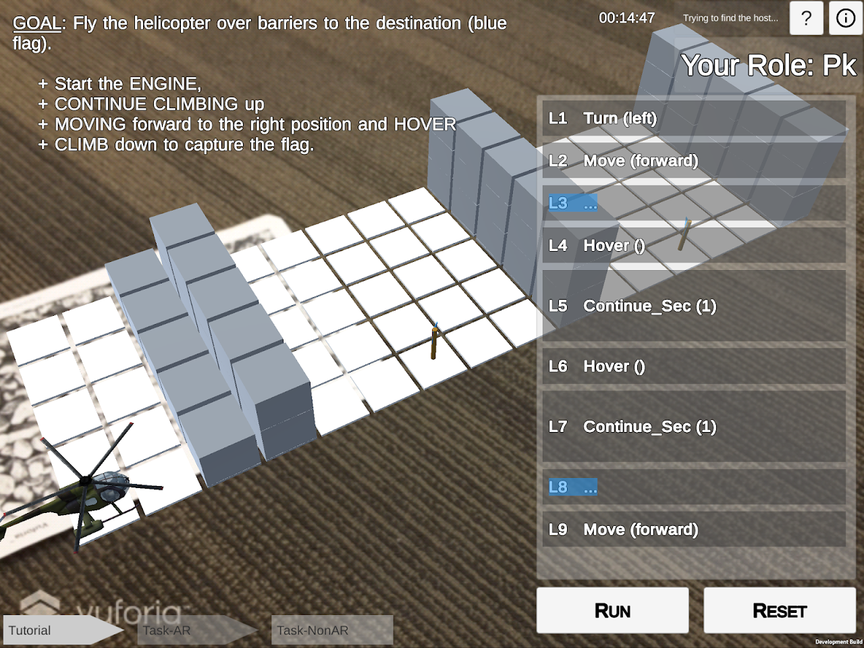
Ogmented design framework aligns CT model
Notes:
V. J. Shute, C. Sun, and J. Asbell-Clarke, “Demystifying computational thinking,” Educational Research Review, vol. 22, pp. 142–158, 2017.

Slide 35
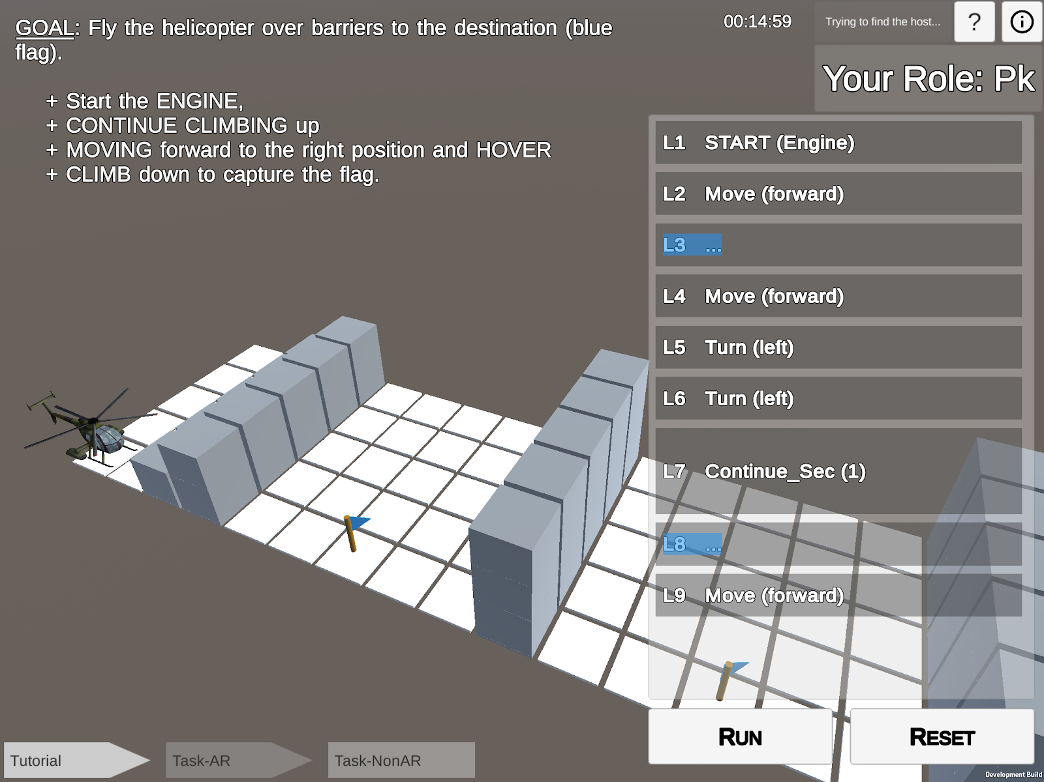
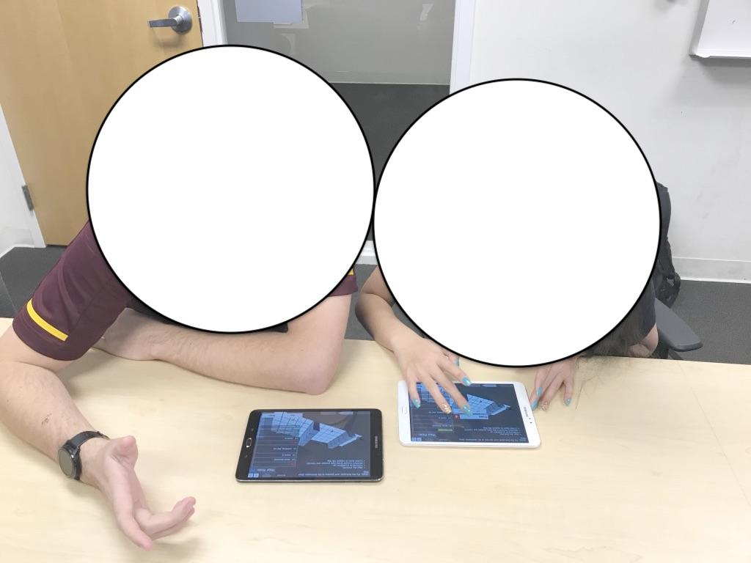
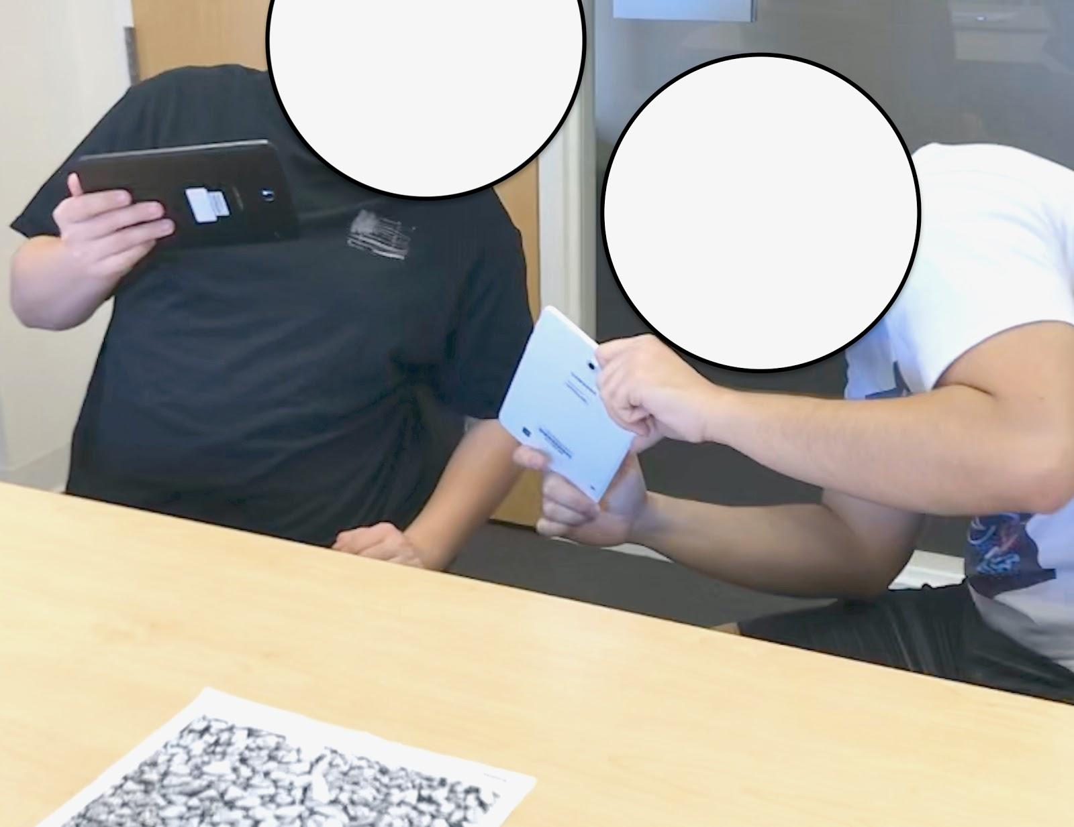
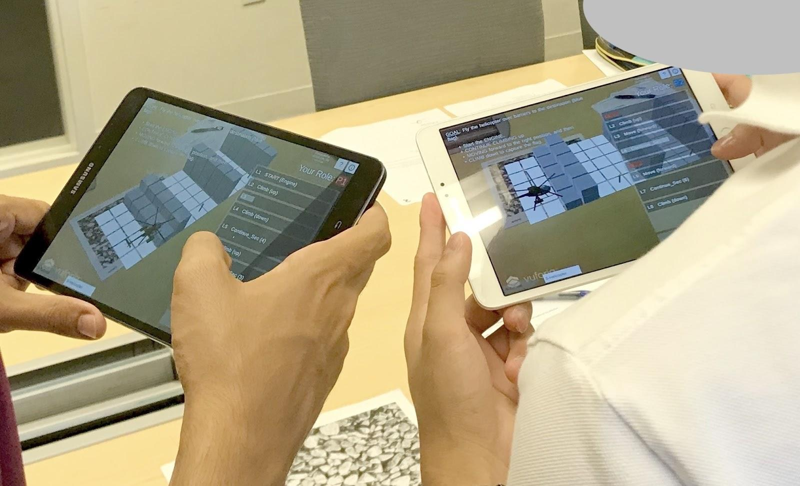
Preliminary Results on
Collaborative Debugging
What are the AR effects?
Do students learn better?
How do they collaborate on a debugging task with and without AR support?
Interface of Debugging Task
Participants Working in NonAR
Participants Adjusting Poses in AR
Participants Working in AR
Notes:
Chung, C. Y., & Hsiao, I. H. (2019, March). An exploratory study of augmented embodiment for computational thinking. In Proceedings of the 24th International Conference on Intelligent User Interfaces: Companion (pp. 37-38).
Chung, C. Y., & Hsiao, I. H. (2020, June). Computational Thinking in Augmented Reality: An Investigation of Collaborative Debugging Practices. In 2020 6th International Conference of the Immersive Learning Research Network (iLRN) (pp. 54-61). IEEE.

Slide 36
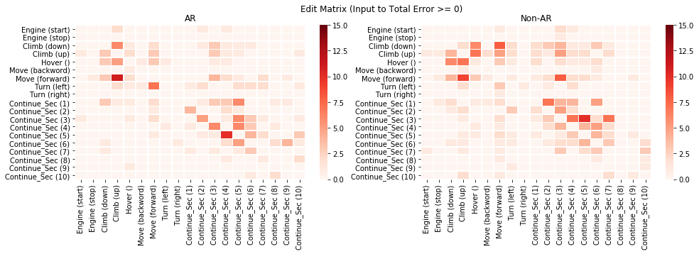
AR group seems to be more efficient than NonAR.
Counts of ineffective edits in AR and NonAR matrix
AR
Non-AR
Edits are concentrated and following steps.
Edits are sparse and all over the place.
Key Code-editing Behavior: AR has a more “concentrated” edit pattern and NonAR is less “concentrated”.

Slide 37
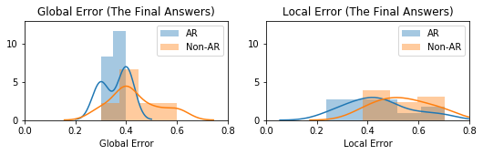
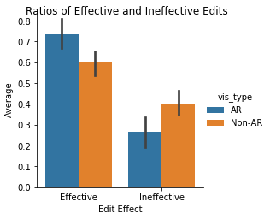
Dyads in AR produced better answers with significant lower global error rate.
Global error (overall code structure) i.e. incorrect functions
Local error (code implementation) i.e. incorrect parameter values
t=-2.40, p=0.03*
AR group had significantly lower ratio of ineffective code edits than NonAR.
Notes:
Measured by edit distance (longest common subsequences).

Slide 38
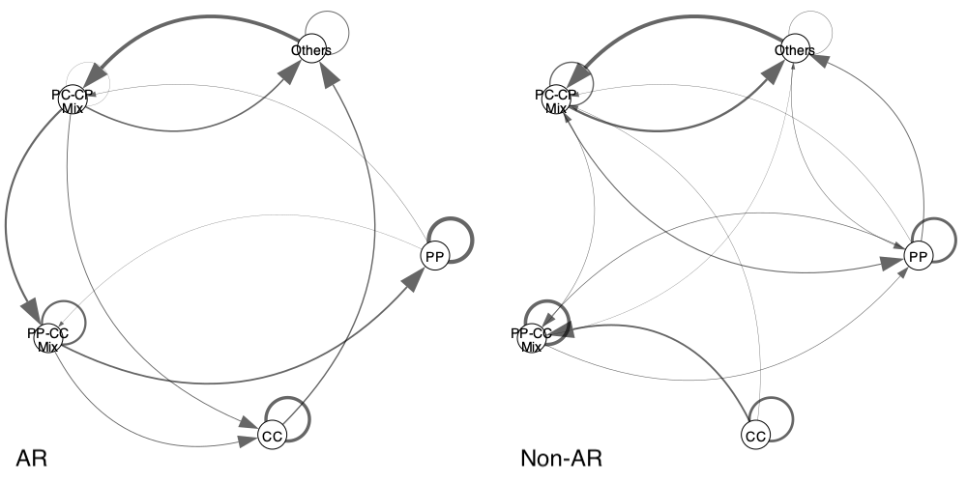
HMM models illustrated that AR had a clearer edit path than NonAR.
AR
Non-AR
Note: P = Parameter Tweaking; C = Command Tweaking;
These two items constitute edit sequences and are captured by “states” in HMM, e.g., PP, PC, etc.

Slide 39
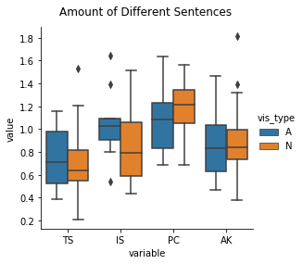
Discourse Analysis revealed that AR group talked more.
TaskState: Relevant to task states and outcomes, e.g., “It went too far."
Inter: Describing an internal states (like intentions, questions, suggestions), e.g., “I think it should be ’climb down’ because..."
Progress: Describing a progress of the task, e.g., “I’ll make it...", “Let’s try...", “Let me try..."
Ack: Acknowledgement, e.g., “yeah.", “okay."
Other: Any others that do not fall into the above categories.
t=-4.79, p=0.00*
AR group asked more questions, made more suggestions, and had more “interactive communication”.
Notes:
Susan R. Fussell, Robert E. Kraut, and Jane Siegel. 2000. Coordination of communication. In Proceedings of the 2000 ACM conference on Computer supported cooperative work - CSCW ’00. ACM Press, New York, New York, USA, 21–30. https://doi.org/10.1145/358916.358947

Slide 40
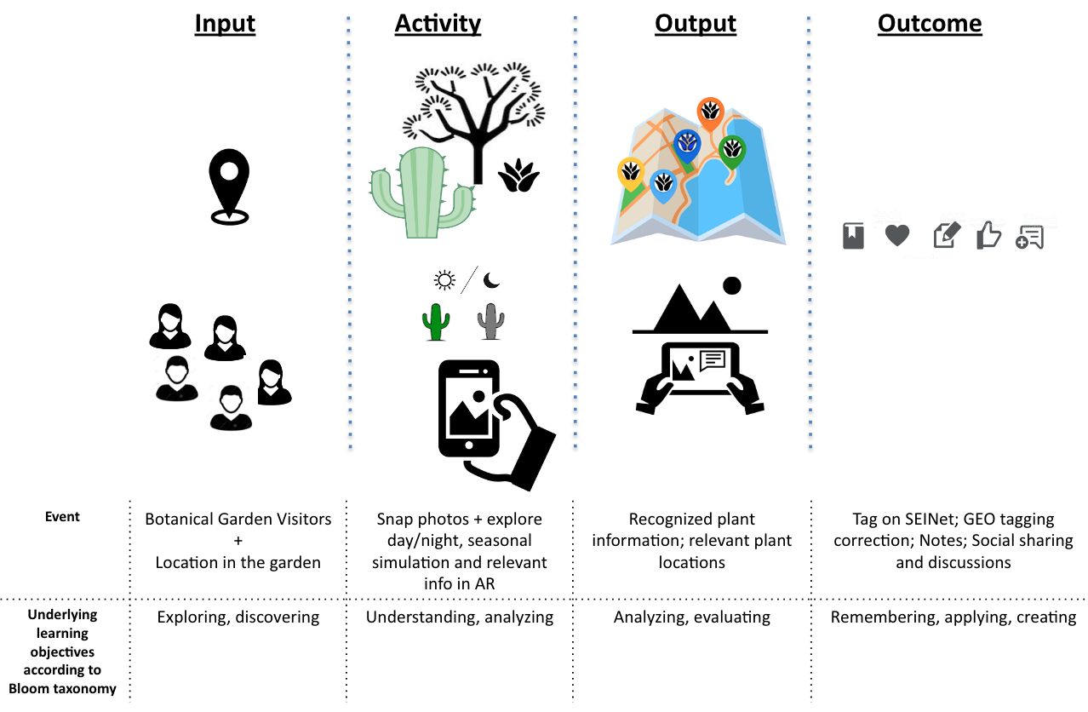
Project current & pending
Collaboration, Coding, Cross-Cultural Communication, and Computational Thinking through Virtual Exchange, Stevens Institute (conditional) <Xavier College Prep + MENA>
(PI) NSF: Collaborative Research: IUSE: Enriching Computational Thinking in Introductory Computing Classes with CIPAR (Collaborative Immersive Programming in Augmented Reality) (pending) <My team + UCDavis >
(PI) NSF: AISL: gARdenView Engaging Botanical Education via Personalized Guidance in Augmented Reality (pending) <Desert Botanical Garden + biodiversity institute>
NSF: HCC: Medium: AR for Upskilling: How Interfaces and Instructional Sequences Interact in a Changing Workforce (pending) <City of Mesa cooling plant>

Slide 41
R2 Publications
Chung, C. Y., & Hsiao, I. H. (2019, March). An exploratory study of augmented embodiment for computational thinking. In Proceedings of the 24th International Conference on Intelligent User Interfaces: Companion (pp. 37-38).
Chung, C. Y., & Hsiao, I. H. (2020, June). Computational Thinking in Augmented Reality: An Investigation of Collaborative Debugging Practices. In 2020 6th International Conference of the Immersive Learning Research Network (iLRN) (pp. 54-61). IEEE.
Chung, C. Y., & Hsiao, I. H. (2021, to appear) Exploring the Effect of Augmented Reality on Verbal Communication and Code-editing Patterns in a Collaborative Programming Task, IEEE The 21st International Conference on Advanced Learning Technologies.
Chung, C. Y., & Hsiao, I. H. Multimodal Analytics of Collaborative Programming Problem-Solving in Augmented Reality, Transactions on Learning Technologies (under review)
...

Slide 42
Thank you!
Dr. Sharon Hsiao
http://www.public.asu.edu/~ihsiao1/
@shoha99

